Slide 1
Customer Churn Analysis
CodeOp Data Science Final Project
by Carmen Márquez Floro

Slide 2
Business case: Churn Analysis
Churn data for a fictional Telecommunications company that provides phone and internet services to 7,043 customers in California, and includes details about customer demographics, location, services, and current status.
What is the typical profile for a customer that churned?
What seem to be the key drivers behind churn?
Is the company losing high value customers?
Can we predict whether a customer will churn, so we can target them with a special promotion?
Can we segment the customers with the features we have? (WIP)
Can we relate the segments we got with churning probability? (WIP)

Slide 3
Main steps of this analysis
Context and EDA
The “churner” profile
The most valuable customer
The most valuable customer at risk
Building a Classification ML model for Churn Prediction (python)
Unsupervised Learning - Segmentation of the customers (WIP)

Slide 4
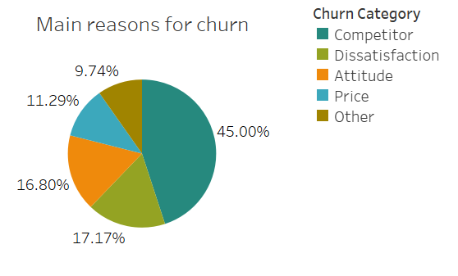
Key-drivers of Churn

Slide 5
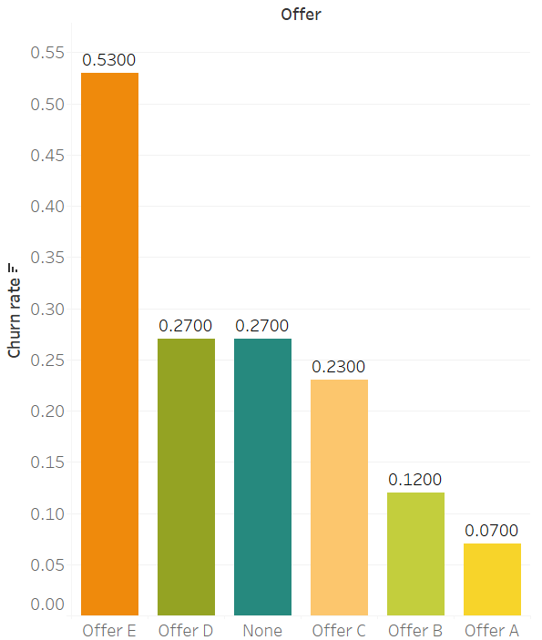
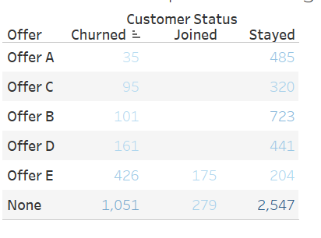
Promotions and Churn
After the company runned a series of promotions, from the results we can observe that although Offer E seems a good idea to capture new customers, it is generating the highest Churn rate on the customer base.

Slide 6

Profile of the “churner”
City: San Diego, Los Angeles, San Francisco
Age: Senior citizen (+ 60)
Marital status: Not married
Type of contract: month-to-month
Paperless billing: yes
Payment method: Bank-withdrawal or mailed check
Link to Dashboard

Slide 7

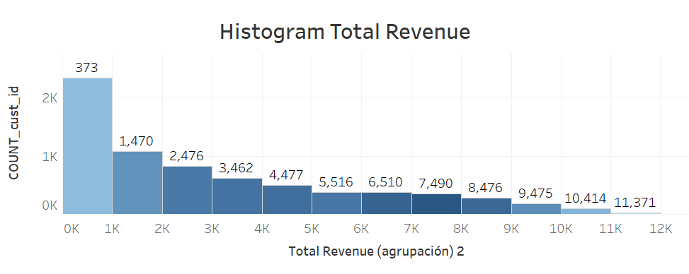
Identify most valuable customers
Criteria: those who contributed the most to generate more than 50% of Total Revenue (customers with highest AVG Total Revenue)

Slide 8
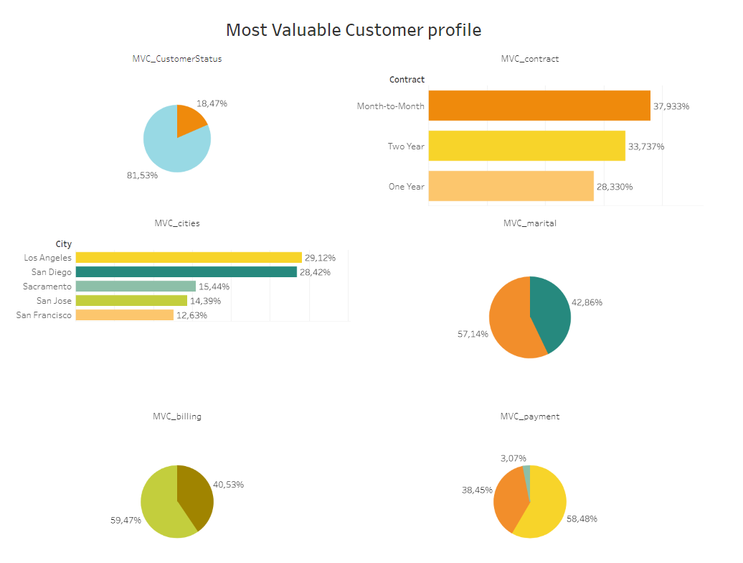
Most valuable customer
Link to Dashboard

Slide 9
Most valuable customer
The overall risk of churn of this type of customer is around 18%
City: more than 10% are concentrated in Los Angeles, San Diego, Sacramento, San Jose and San Francisco
Marital status: 57% are married
Type of contract: month-to-month contract (38%), 2-years contract (34%)
Paperless billing: 60% are paperless
Payment method: Bank withdrawal (58%), followed by Credit card (39%)
Services: 70% have contracted both Internet and Phone services

Slide 10

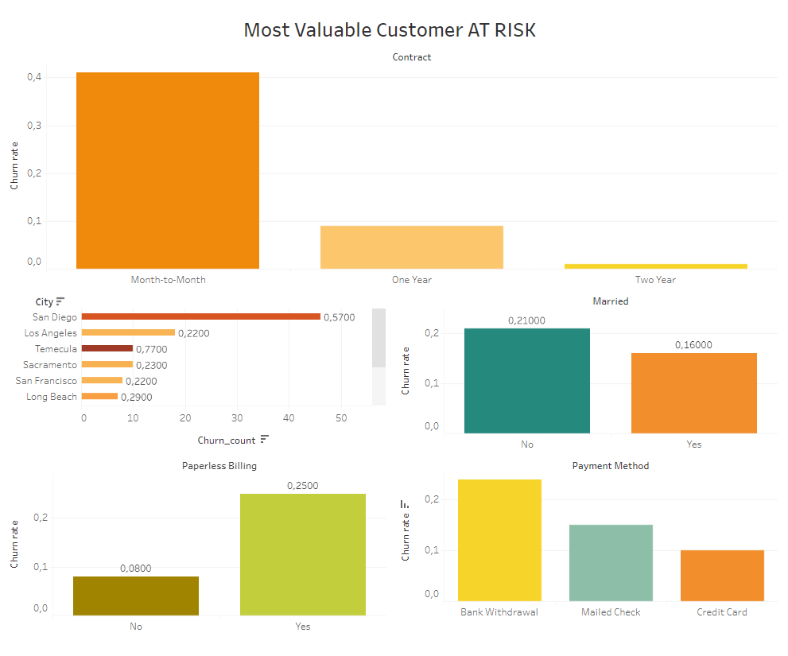
Most valuable customer at risk
Link to Dashboard

Slide 11
Most valuable customer at risk
Most valuable customers at highest risk of cancelling their contract present the following characteristics:
City: San Diego, Los Angeles and Temecula
Marital status: Not married (21% churn rate)
Type of contract: month-to-month contract (41% churn rate)
Paperless billing: Yes (25% churn rate)
Payment method: Bank withdrawal (24% churn rate), followed by Mailed check (15% churn rate)

Slide 12
Recommendations
Launch localized promotions in the cities with highest Churn rate
Encourage month-to-month contract customers to swap to at least one-year contract. An idea: Premium tech support for free for customers with 1 or 2 years contract
Create incentives for the customers to swift to Credit card payment method
Target Senior customers with specific promotions aiming to retain them
Send paper bills to Senior customers, since they present the highest churn rate in the paperless billing category

Slide 13
Recommendations
As of the main reasons for churning:
Higher investment in Market research (competition tracking), keeping competitive prices
Refine and better train in the customer support team
Stop using offer E, since it is creating a significant amount of churn
Specific promotions targeting the Most Valuable Customer at risk

Slide 14
Appendix

Slide 15
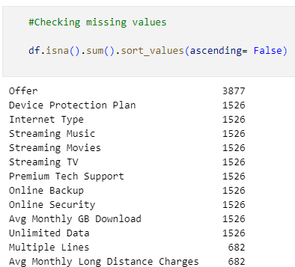
Summary additional EDA with Python
Dealing with missing values
There are 7.043 records
Offer: “None” replaced by “No promotion”
In the internet services related columns: 1.526 missing values, referring to the number of customers who contracted only Phone service
Regarding the 682 missing values in the "Avg monthly long distance charges" and "Multiple lines" columns, these belong to customers that only contracted internet based services.
I understood that the "missing values" I found make sense in this dataset, I have decided to refined the meaning behind those missing values, so it is clearer and to avoid losing that data.

Slide 16
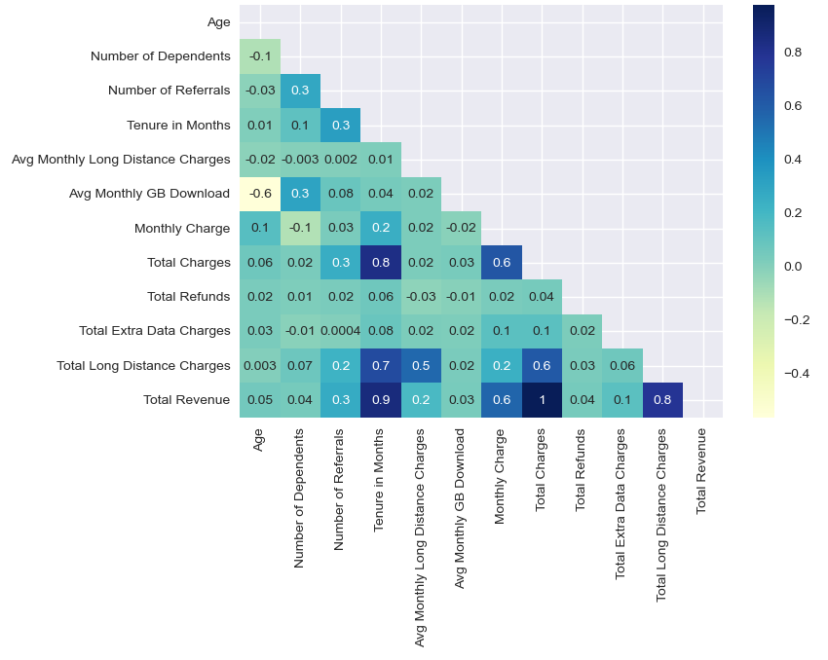
Summary additional EDA with Python
Correlation Matrix
Age is negatively (-0.6) correlated with Avg monthly GB Download, the older the customer the less GB downloads they use
Tenure (months) is highly correlated with Total Revenue (0.9), Total Charges (0.8) and Total Long Distance Charges (0.7). It makes sense that the longer the customer has been in the company
Total Charges is highly correlated with Total Revenue (1)
Total Revenue is also highly correlated with Total Long Distance Charges (0.8)
I will drop "Total Revenue" to avoid Multicollinearity in my model

Slide 17
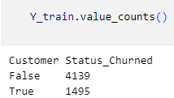
Churn Prediction Classification Model
Imbalance class detected
Handling the Class imbalance it's important because on such data, models become good at predicting the majority class but perform poorly on the minority class
There are numerous techniques to handle class imbalance (undersampling, Oversampling (SMOTE), Ensemble Method, Class Weights, Focal Loss...)
These techniques should only be applied to the training data and the resulting model should be evaluated on the original test data.

Slide 18
Churn Prediction Classification Model
Imbalance class handling
I decided to use SMOTE because it is particularly useful when the class imbalance is severe and the minority class is significantly underrepresented. It is also useful when there is limited data available for the minority class, as it can create additional synthetic samples to improve model performance

Slide 19
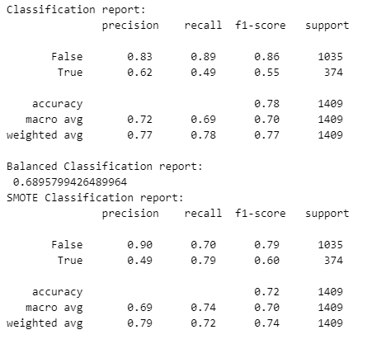
Churn Prediction Classification Model
Logistic Regression Model results
From this results we can see that after applying the SMOTE method to deal with the imbalance class issue, the accuracy is 0.72, which is close to the regular accuracy score (0.78), and higher than the balanced accuracy score (0.68)

Slide 20
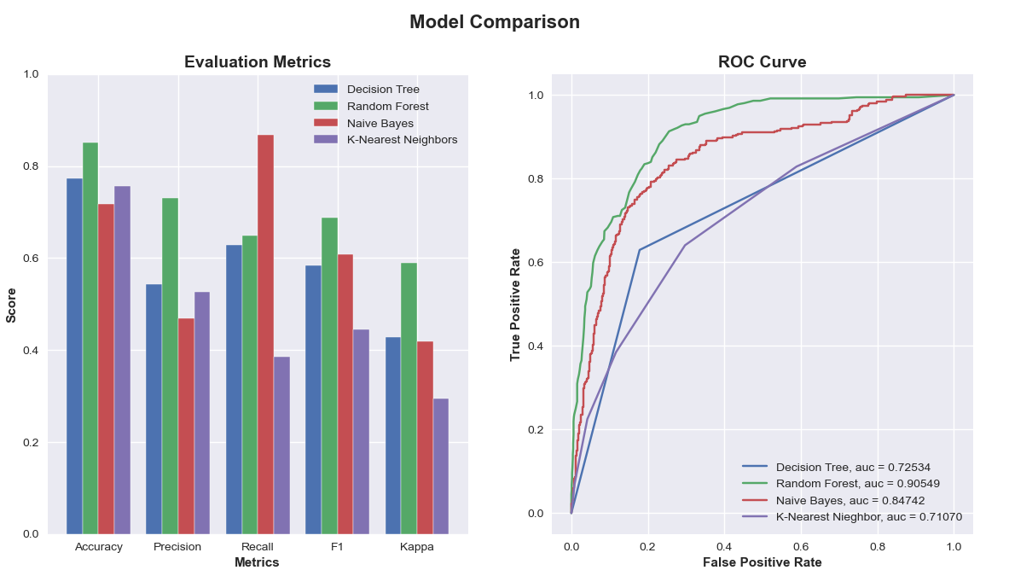
Churn Prediction Classification Model
Other Classification models
From the chart above, I can observe that the Random Forest it´s the winner model in all the evaluation metrics (except for Recall).
So I think it's the right choice to solve this business case.

Slide 21
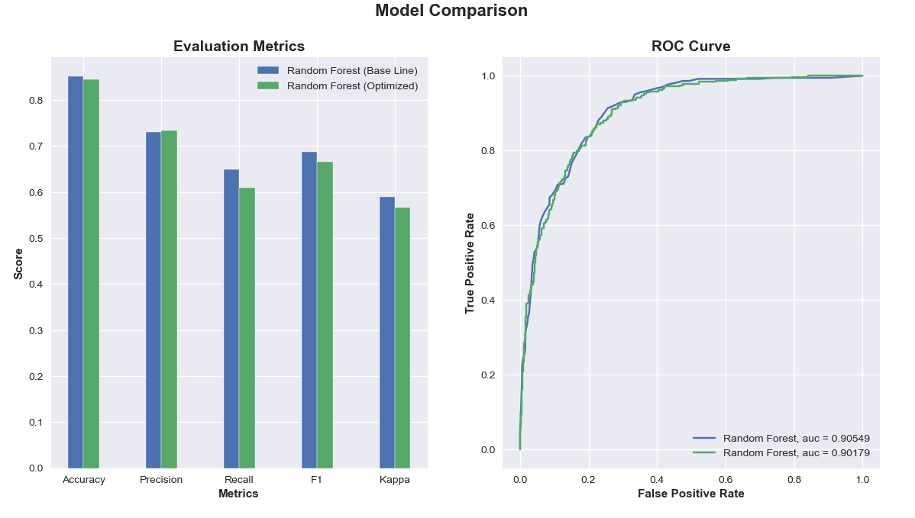
Churn Prediction Classification Model - Optimization
Random Forest model
Trying to optimize our Random Forest model by tuning the hyper parameters (using the scikit-learn library) and then i will evaluate this refined model with the baseline one and see which one performs better.
The RF Optimized model is just performing a bit better than the original model on precision. So, I decide to stick with the original model for the prediction and most of the evaluation metrics show better results

Slide 22
Churn Prediction Classification Model - Conclusion
Random Forest model
In simpler terms, our RF model did a decent job at classifying the data, but it's not perfect.
One area where it struggled with is Recall.
Even after fine-tuning the model using GridSearchCV, the improvement wasn't significant, suggesting we might have reached the model's limit. To boost performance, I could explore using a different algorithm like GradientBoostingClassifier.

Slide 23
Main challenges
Creating new variables
Addressing missing values
Handling imbalance class issue
Interpreting the model

Slide 24
Additional observations
Customer loyalty: Avg Tenure is positively correlated with age (the older, the longer the customer stays in the company)
Customer loyalty: Avg Tenure for customers who churned is almost 18 months
No difference in Churn rate by gender

Slide 25
THANK YOU

Slide 26
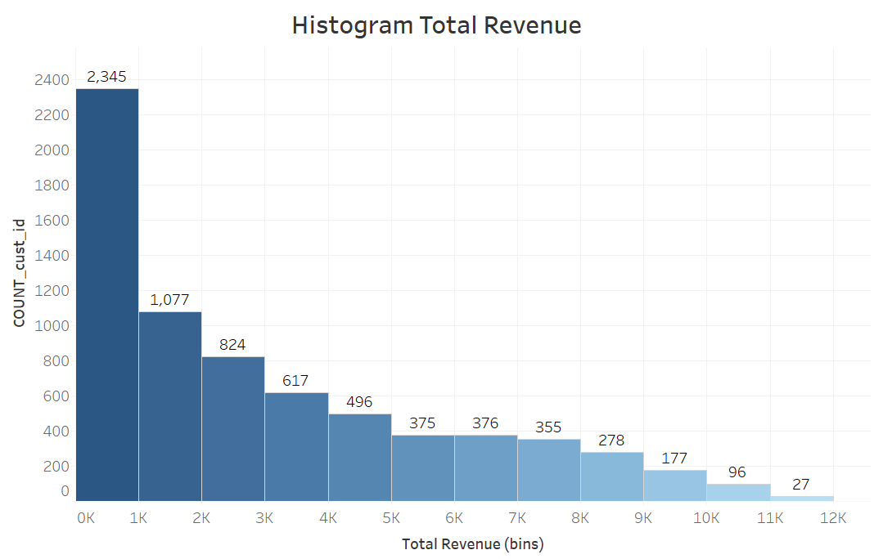
Total Revenue distribution
Positively-skewed distribution, meaning that most valuable customers fall in the right tail
Customers in the left, are the type of customers that brings small revenue, so the company need to acquire many customers to make some money

Slide 27
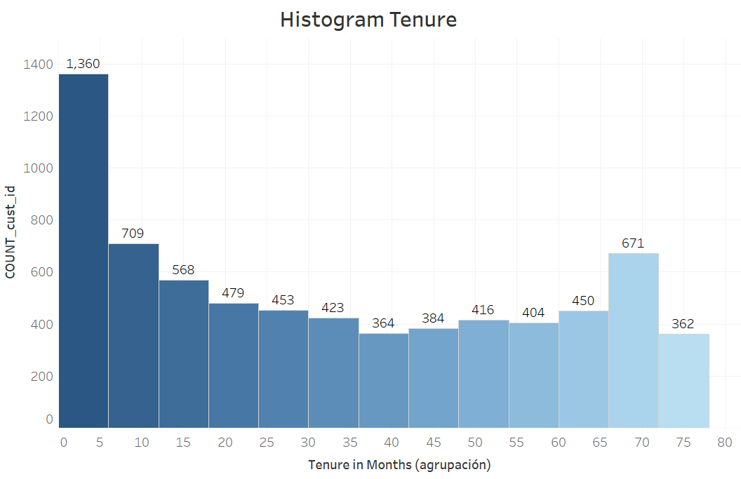
Total Revenue distribution
Positively-skewed distribution
Most loyal customers fall in the right tail
The type of customer in the left are the ones that stays for a shorter period of time in the company (should be the ones with higher churn rate)

